Slide 1
FORMS
U3.L5- Introduction to Forms

Slide 2

DO NOW
Think about the website you visit the most.
What information can be found there?
Do you need to log-on?
How easy is it for you to find the information you need? - Explain

Slide 3

Agenda
Do Now
How To Create a form on a website
The different tools for collecting data
HTML5 Form Controls
Navigation (Review)
Work Time

Slide 4

Objectives
Create a basic search input box with a search button to create a search bar using the <form> and <input> tag, the action and method attributes.
Understand how to create a form page, by creating a feedback and signup form for a Newsletter using a variety of form controls.

Slide 5
What’s a form?
Traditionally, the term 'form' has referred to a printed document that contains spaces for you to fill in information.
HTML borrows the concept of a form to refer to different elements that allow you to collect information from visitors to your site.
Whether you are adding a simple search box to your website or you need to create more complicated insurance applications, HTML forms give you a set of elements to collect data from your users.

Slide 6

Notes:
The best known form on the web is probably the search box that sits right in the middle of Google's homepage.
In addition to enabling users to search, forms also allow users to perform other functions online.
You will see forms when registering as a member of a website, when shopping online, and when signing up for newsletters or mailing lists.

Slide 7
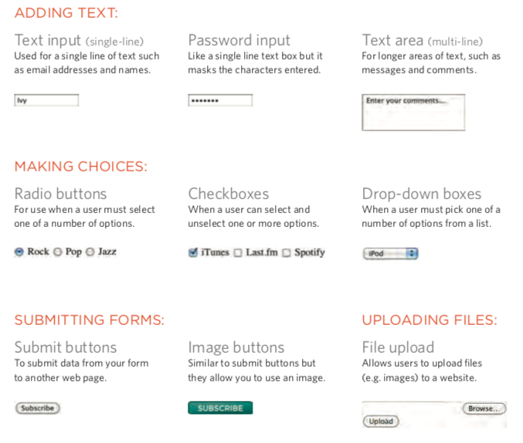

Slide 8
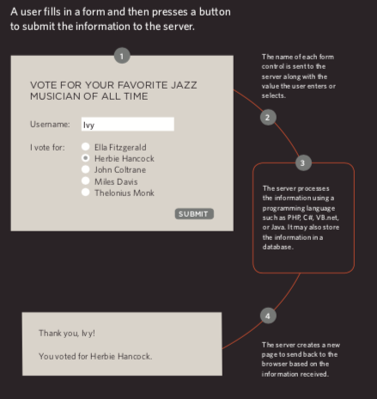
How Forms Work

Slide 9
[LIVE DEMO]
Creating a Form

